Slide 1
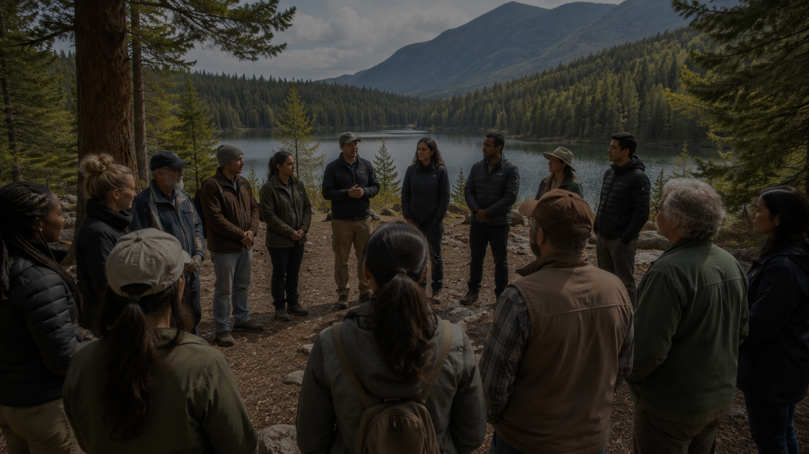
CETS Part II Seminar | Gauja National Park, Latvia
Implementing the European Charter for Sustainable Tourism: the Italian Experience and the Case of Sila National Park
Federparchi – EUROPARC Italy and the Sila National Park experience
Ada Occhiuzzi
Sila National Park
Notes:
Open by thanking the organisers and participants.
State the aim: to share a practical Italian experience, from CETS Part I to Part II and towards Part III.

Slide 2
ROADMAP
What this contribution will cover
Federparchi – EUROPARC Italy
1
How the Italian section supports parks and strengthens the national CETS network.
The Charter as a process
2
Why CETS is a governance tool, not only a certificate.
The Sila National Park case
3
From Part I to Part II, with the Forum at the centre and a pathway towards Part III.
Federparchi – EUROPARC Italy | European Charter for Sustainable Tourism
02
Notes:
This slide sets the structure of the intervention. Keep it simple and use it to orient the audience.

Slide 3
1. OPENING
A double perspective: network and territory
1
2
3
Institutional voice
Operational experience
Practical learning
Ada speaks on behalf of Federparchi – EUROPARC Italy, bringing the perspective of the Italian CETS network.
The Sila National Park case shows how the Charter is implemented in a real destination.
The aim is to offer transferable lessons for Latvian parks and local tourism businesses.
The Charter becomes effective when it is recognised by the territory as a shared way of working.
Federparchi – EUROPARC Italy | European Charter for Sustainable Tourism
03
Notes:
Mention the two connected levels: national coordination and local implementation.

Slide 4
2. FEDERPARCHI – EUROPARC ITALY
The Italian section as a national reference point
Role
1
2
3
Federparchi promotes the European Charter for Sustainable Tourism in Italy and supports protected areas in the Charter process.
Guidance
Exchange
Network
It also helps keep the CETS network active through exchange, methodological support and peer learning.
A national platform that connects local implementation with the wider EUROPARC framework.
Federparchi – EUROPARC Italy | European Charter for Sustainable Tourism
04
Notes:
Avoid going into administrative detail. Present Federparchi as an enabling structure for Charter implementation in Italy.

Slide 5
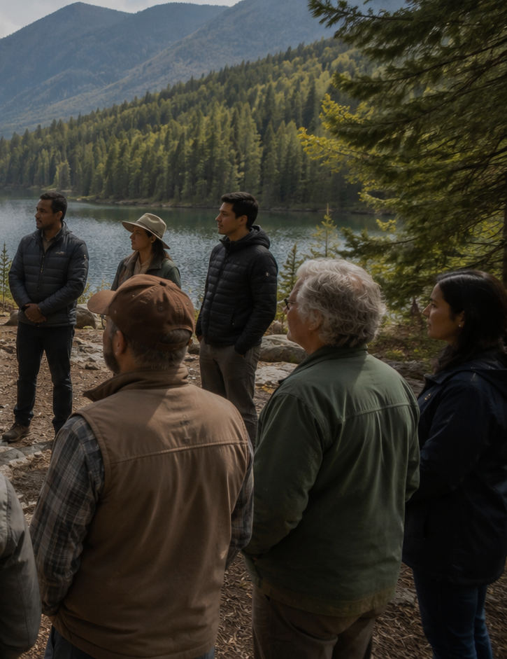
WHY CETS MATTERS
More than certification: a governance tool
Common vision
A shared strategy for sustainable tourism in protected areas.
Conservation link
Tourism development aligned with nature protection objectives.
Local development
Benefits for communities, businesses and destination identity.
Quality of experience
A better, more authentic visitor experience.
The value of CETS lies in the process it activates: dialogue, commitments, monitoring and shared responsibility.
Federparchi – EUROPARC Italy | European Charter for Sustainable Tourism
05
Notes:
This slide can be used to explain why Latvia’s move into Part II is important.

Slide 6
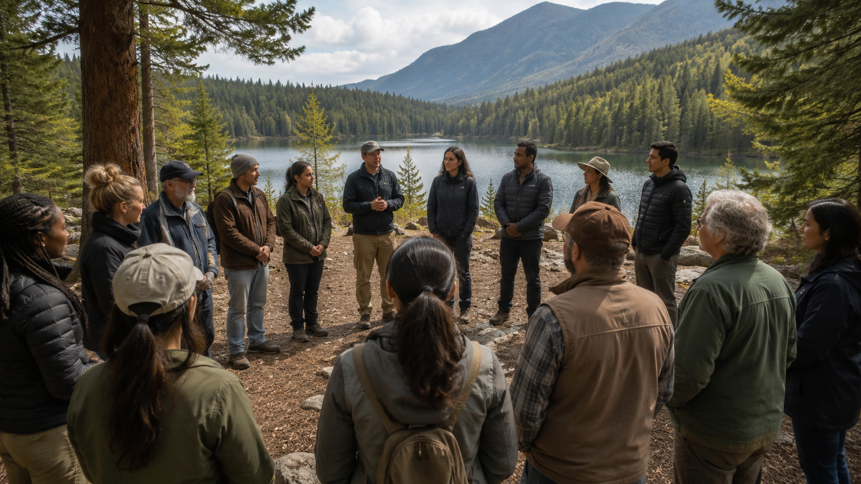
3. PARTICIPATION
The Forum is the heart of the Charter
Builds trust
1
between the park, businesses, institutions and communities.
Identifies needs
2
and translates them into realistic shared actions.
Keeps continuity
3
after certification, during implementation and review.
Creates ownership
4
so that the Charter belongs to the territory.
Without the Forum, the Charter risks becoming a document. With the Forum, it becomes a living governance process.
Federparchi – EUROPARC Italy | European Charter for Sustainable Tourism
06
Notes:
This is the main conceptual slide. Emphasise the Forum as a permanent working space, not a one-off meeting.

Slide 7
4. SILA NATIONAL PARK
A mountain protected area and a sustainable tourism destination
Natural assets
Forests, mountains, lakes and high biodiversity.
Tourism profile
Nature tourism, slow travel, hiking, education, rural and food experiences.
Initial challenge
Build a common destination identity and connect tourism with conservation.
Sila National Park
Calabria, Southern Italy
Federparchi – EUROPARC Italy | European Charter for Sustainable Tourism
07
Notes:
Present Sila as a territory where tourism, local identity and nature conservation need to work together.

Slide 8
5. CETS PART I
Starting the Charter process in Sila
1
2
3
4
5
Context analysis
Stakeholder engagement
Forum activation
Shared strategy
Action plan
Part I created the common framework: a shared destination strategy and a concrete programme of actions.
Federparchi – EUROPARC Italy | European Charter for Sustainable Tourism
08
Notes:
Use this slide to explain Part I as the foundation: analysis, participation, strategy and action plan.

Slide 9
6. RESULTS OF PART I
What changed in the relationship between Park and territory
1
2
3
Dialogue improved
Awareness grew
Actions became shared
Operators, institutions and the Park began to work around a common table.
The protected area was increasingly perceived as an opportunity for quality tourism.
The strategy produced concrete commitments and clearer destination identity.
The first success was not the certificate itself, but the creation of a working relationship with the territory.
Federparchi – EUROPARC Italy | European Charter for Sustainable Tourism
09
Notes:
Stress that relational outcomes are central: trust, awareness, shared planning.

Slide 10
7. THE SILA CETS FORUM
A permanent space for co-design and monitoring
Functions of the Forum
Listen to local needs
Cultural actors
Local producers
Co-design feasible actions
CETS
Forum
Share responsibilities
Municipalities
Tourism businesses
Monitor progress over time
Connect Part I and Part II
Associations
Guides
Federparchi – EUROPARC Italy | European Charter for Sustainable Tourism
10
Notes:
Describe who participates in the Sila Forum and how it works as a bridge between the Park and stakeholders.

Slide 11
8. FROM PART I TO PART II
From destination strategy to certified partner businesses
Part I
Part II
The protected area and its territory define a shared strategy and action plan for sustainable tourism.
Local tourism businesses take concrete commitments consistent with the Charter and become certified partners.
Part II is the natural evolution of a strong Part I: it brings the Charter inside the daily choices of tourism operators.
Federparchi – EUROPARC Italy | European Charter for Sustainable Tourism
11
Notes:
Explain the difference between Part I and Part II clearly. This is particularly relevant for the Latvian audience.

Slide 12
9. ACCOMPANYING OPERATORS
How the Park supports tourism businesses in Part II
Explain
criteria, commitments and benefits.
Align
business actions with the Park’s strategy.
Facilitate
the relationship between tourism and conservation.
Recognise
operators as ambassadors of the protected area.
The operator is not a passive recipient of rules, but a co-responsible actor in the destination.
Federparchi – EUROPARC Italy | European Charter for Sustainable Tourism
12
Notes:
Use practical language. Mention meetings, criteria discussion, commitment definition and candidacy support.

Slide 13
10. BENEFITS OF PART II
Value for businesses, the Park and the destination
1
2
3
For businesses
For the Park
For the destination
Recognition, network, quality improvement, stronger relationship with the Park.
More aware operators, better cooperation and stronger conservation messages.
Clearer identity, integrated offer, slow travel and community value.
A credible sustainable destination is built by the combined commitments of many local actors.
Federparchi – EUROPARC Italy | European Charter for Sustainable Tourism
13
Notes:
Highlight practical benefits requested by the organisers: slow travel audiences, destination identity, cooperation.

Slide 14
11. LESSONS LEARNED
What makes the Charter work in practice
Common challenges
Operational lessons
Involve operators with different timeframes and expectations
Start by listening to the territory
Explain that CETS is not only a label
Use simple and concrete language
Keep participation alive after certification
Value the most motivated operators
Turn ideas into measurable actions
Keep the Forum active over time
The Charter works when it becomes a permanent working method, not a project with an end date.
Federparchi – EUROPARC Italy | European Charter for Sustainable Tourism
14
Notes:
Be candid about difficulties. This will make the experience more useful for parks beginning Part II.

Slide 15
12. TOWARDS PART III
Connecting the protected area with the tourism chain
Part I
Part II
Part III
Destination strategy
Local certified businesses
Tour operators and sustainable packages
Part III can strengthen the destination, but only if the local network created through Part I and Part II is mature and credible.
Federparchi – EUROPARC Italy | European Charter for Sustainable Tourism
15
Notes:
Describe Part III as the extension to tour operators and sustainable packages that remain coherent with local values.

Slide 16
13. TWO VOICES
Why the Park + stakeholder perspective is valuable
Park perspective
Stakeholder perspective
Governance, conservation objectives, strategy, facilitation and coherence of the Charter process.
Concrete motivations, everyday challenges, benefits perceived by businesses and territorial ownership.
The dialogue between Ada and Carmen can show how trust is built and how the Charter becomes operational.
Federparchi – EUROPARC Italy | European Charter for Sustainable Tourism
16
Notes:
Introduce Carmen Fiore as a stakeholder and member of the CETS Forum. Emphasise the complementary perspectives.

Slide 17
KEY MESSAGES
Transferable points for Latvian parks and entrepreneurs
1
Do not start from the certificate: start from a shared vision.
2
Make the Forum the engine of the process.
3
Treat operators as protagonists, not as recipients of rules.
4
Use the Park as a facilitator of cooperation and quality.
5
Keep conservation and tourism in the same conversation.
6
Measure progress and keep the process alive over time.
Federparchi – EUROPARC Italy | European Charter for Sustainable Tourism
17
Notes:
This slide can be a concise recap before the final conclusion.

Slide 18
Conclusion
The Charter is powerful because it brings nature, communities and tourism around the same table.
The Forum is where this alliance takes form. Sustainability becomes real when it is shared, practised and reviewed over time.
Thank you
Notes:
Thank the organisers again and underline that the Sila experience is not a model to copy, but a case to adapt to each territorial context.

